Slide 1


Data Hackathon
February 26th
Karan Polobotu & Gary Kong

Slide 2
Presentation Overview
Consumer Demographic
Presentation Goals
General Statistical Data
Multivariate Models
Conclusions
Further Research

Slide 3
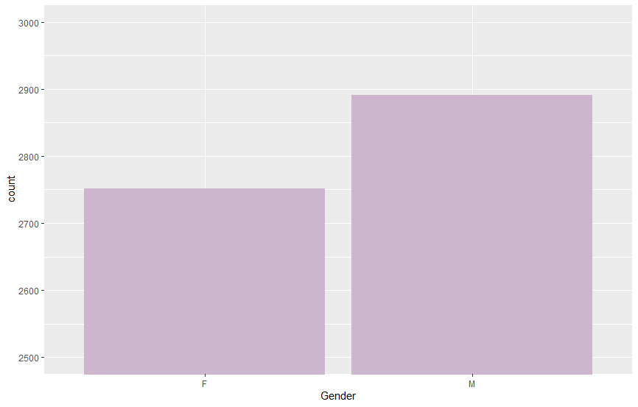
Customer Demographic
5643 total customers
0.51% Male (2891)
0.49% Female (2752)

Slide 4
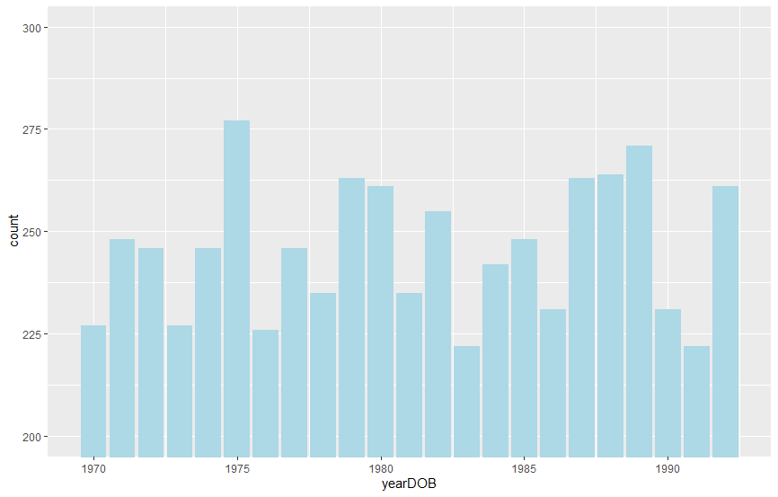
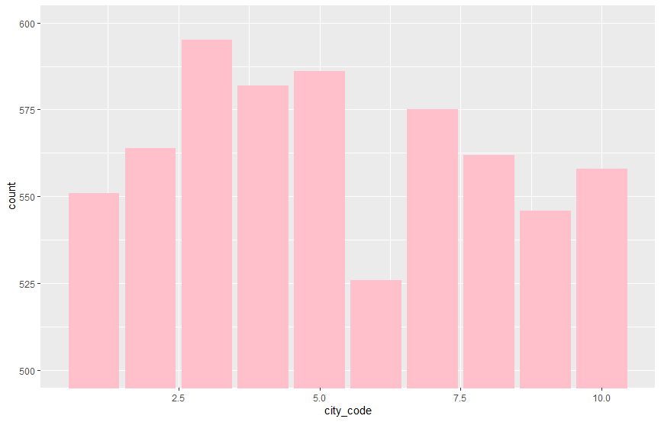
Customer Demographic
Date of Birth
City Code

Slide 5
Presentation Goals
01
Identify areas of improvement
02
Organize and present the available data
03
Provide valuable insights into the data analysis conducted
04
From the information given, suggest solutions or areas of improvement.

Slide 6
General Statistical Data
 | E-shop | Flagship | MBR | Teleshop
Total Visits | 9311 | 4576 | 4660 | 4503
Average amount spent per visit: $2616.93
Total Amount Earned: $60, 328,097
Total Unique Customers: 5648

Slide 7
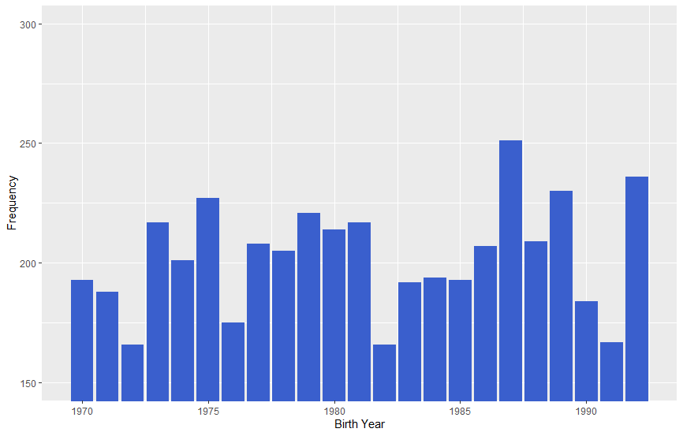
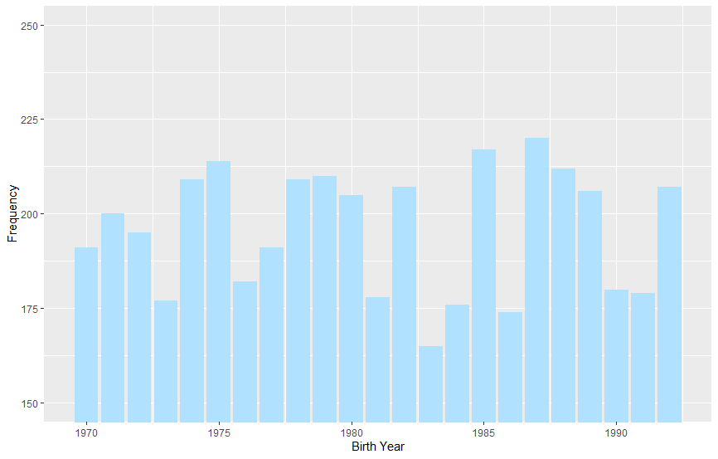
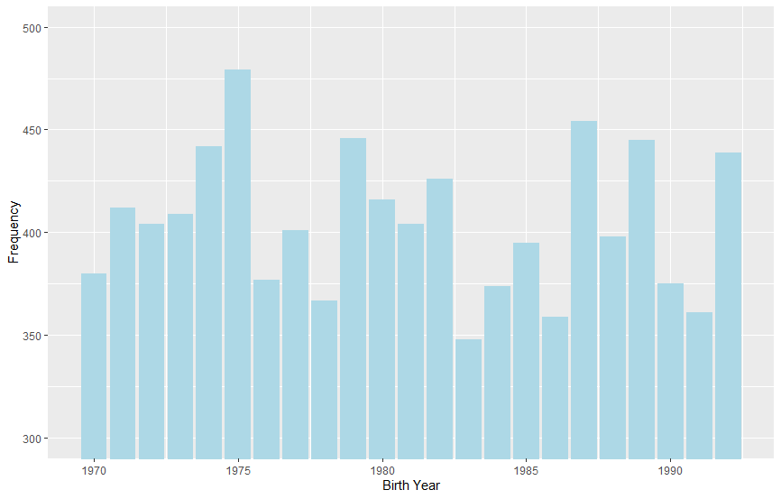
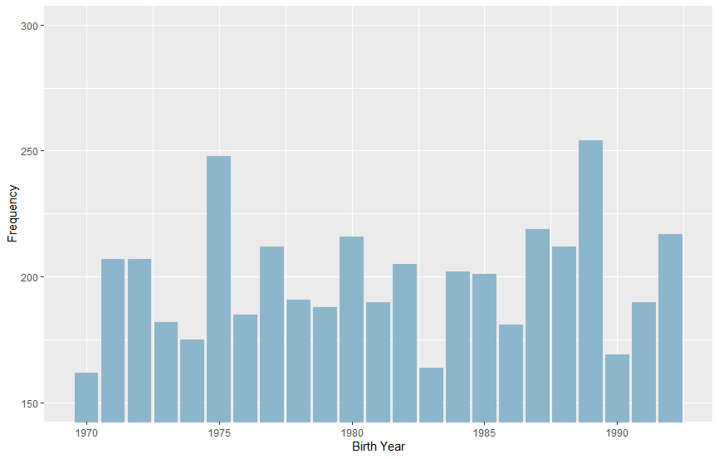
Brick and Mortar (MBR)
TeleShop (By Phone)
E-Shop (Online)
Flagship Store

Slide 8
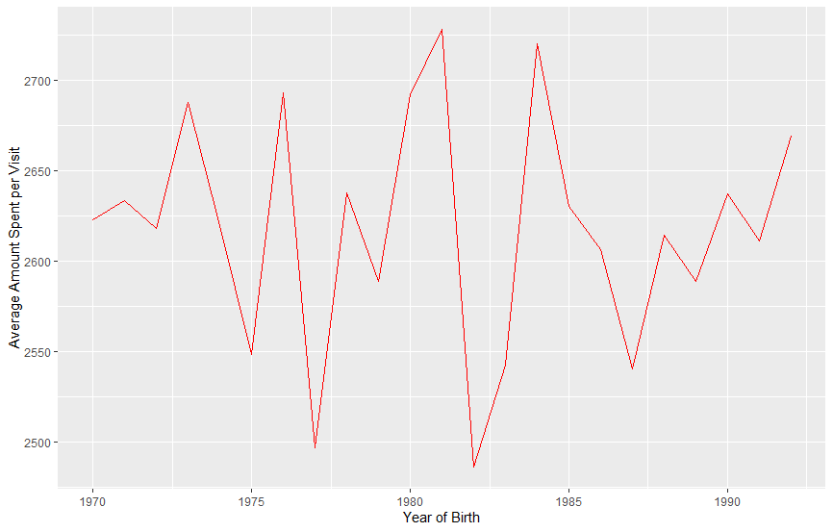
Average Amount Spent per Visit by Birthdate

Slide 9
Conclusions
01
02
Demographic Increase
Marketing towards Generation Z
Closure of In-person branches
Covid-19 restrictions and major electronic sales
S

Slide 10
Further Research
Store Type with Quantity
05
Influence of monthly date of transaction amounts and frequency
03
04
Quantity changes based on age
Types of products sold
01
02
Location of transactions

Slide 11
Thank you for Listening! If you have any questions, feel free to email me at 18gk14@queensu.ca (Gary) or polobotu@gmail.com (Karan)

